Slide 1
Module 1:
Neural Networks and Deep Models
Multi-layer Perceptron; ConvNets
ML for Cybersecurity
November 10, 2020

Slide 2
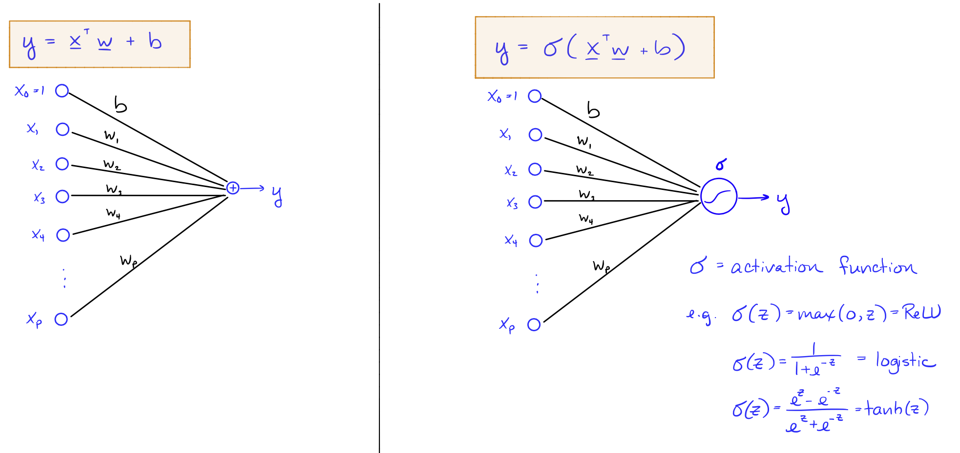
A Simple Neural Network

Slide 3
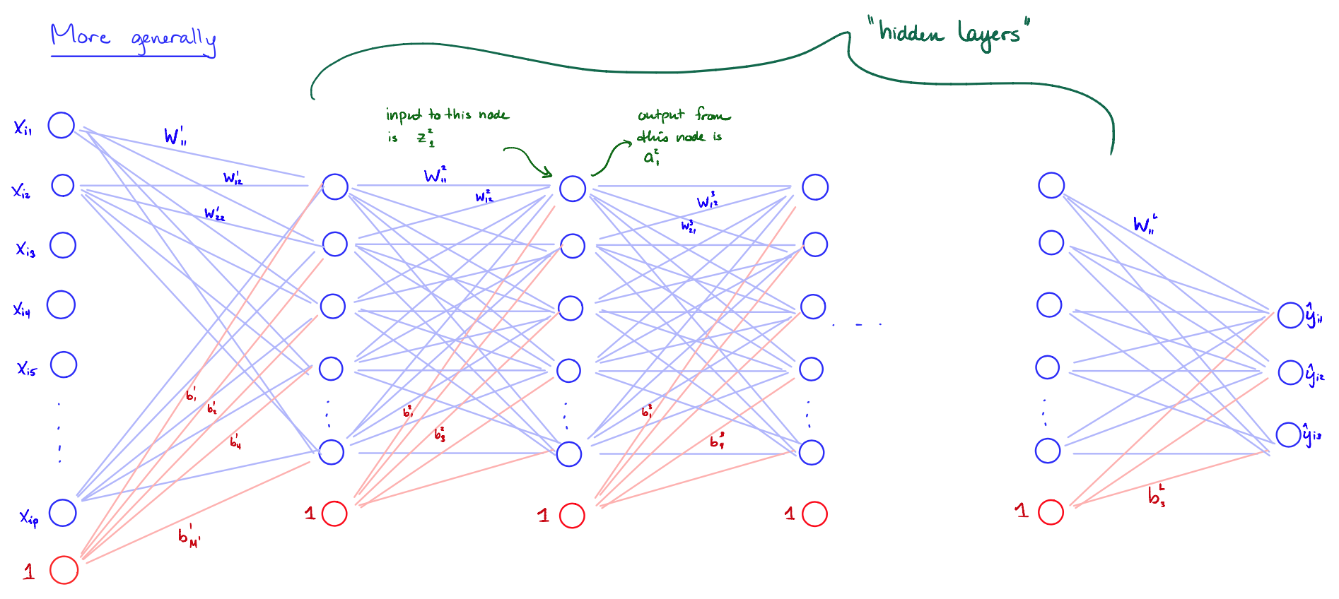
Multi-layered Networks (e.g., Perceptrons)

Slide 4
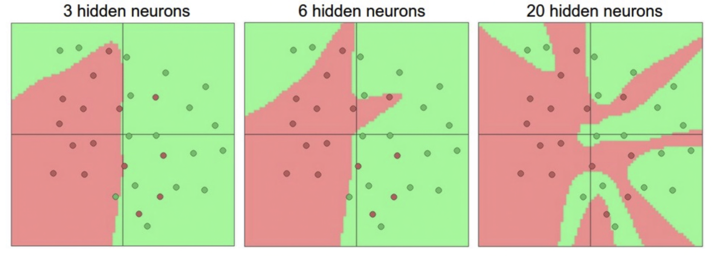
Representation Power
Neural network with one hidden layer is a universal approximator (can represent any function)
The capacity increases with more hidden layer and hidden units

Slide 5
Training Multi-layered Networks: Optimization
Neural nets can be trained via stochastic gradient descent
For deeper neural network, one can updates the weights via backpropagation
Initialization of neural nets
Initializing weights
usually initial weights are chosen to be random values near zero
Scaling input:
Standardize all inputs to have zero mean and standard deviation = 1 (making it easier to choose a good range of initial weights and easier to regularize)

Slide 6
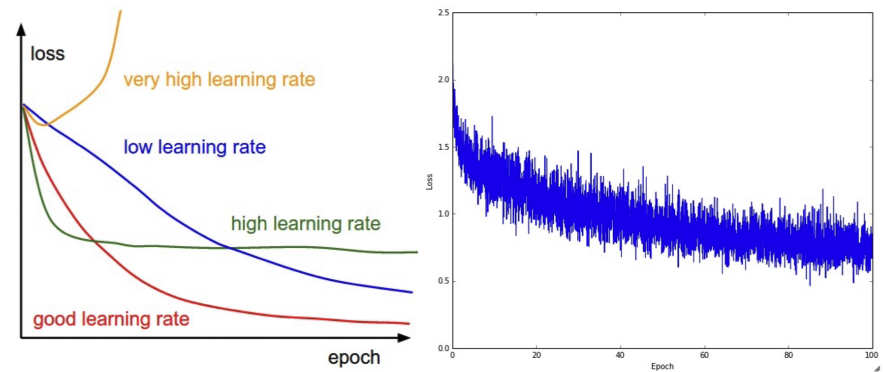
Training Multi-layered Networks: Learning Rate
How often to updates weights
Update weights after utilizing every mini-batch of training examples (i.e., an epoch)
How much to update
Learning rate effect

Slide 7
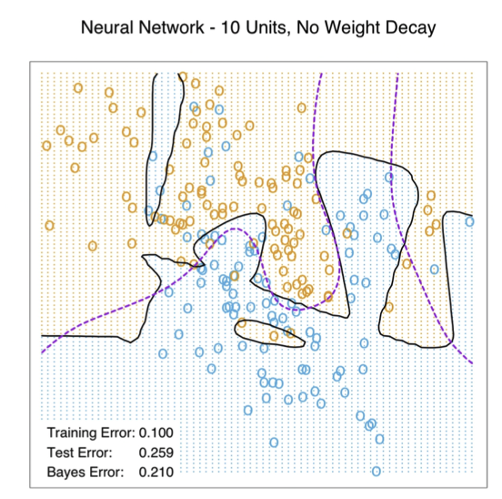
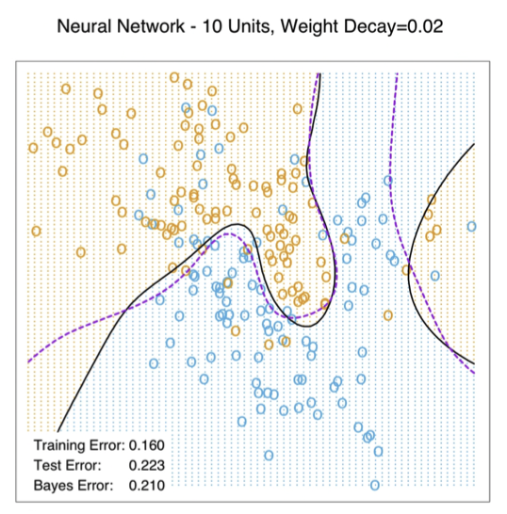
Training Multi-layered Networks: Overfitting
Early stopping
Train the model for a while but stop before convergence
Weight decay
Adding regularization to loss function
Encouraging models with “small” weights

Slide 8
Deep Models

Slide 9
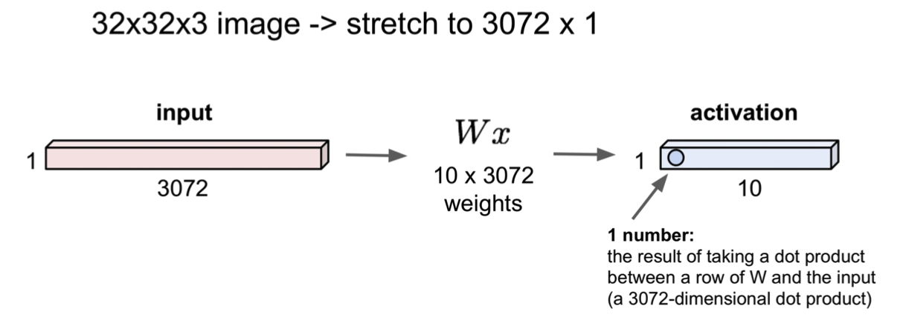
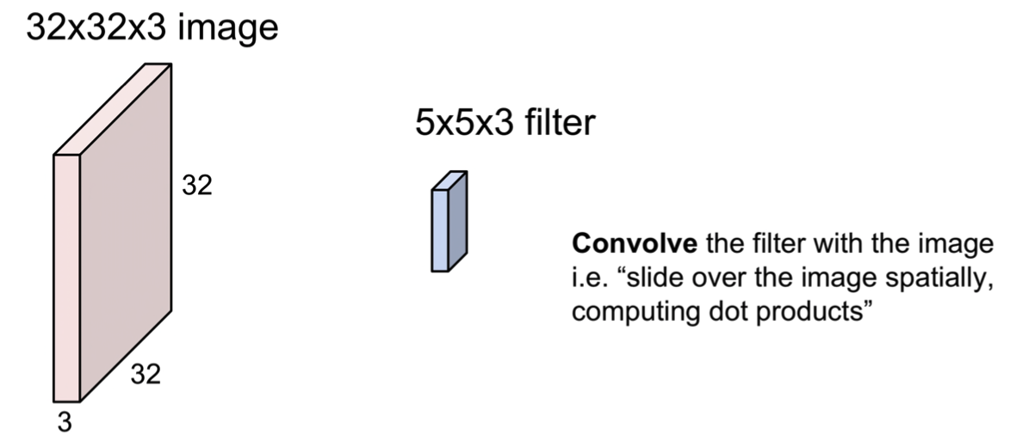
Convolutional Neural Nets
Fully connected layers
Convolutional layers
Credit: http://cs231n.stanford.edu/slides/2018/cs231n_2018_lecture05.pdf

Slide 10
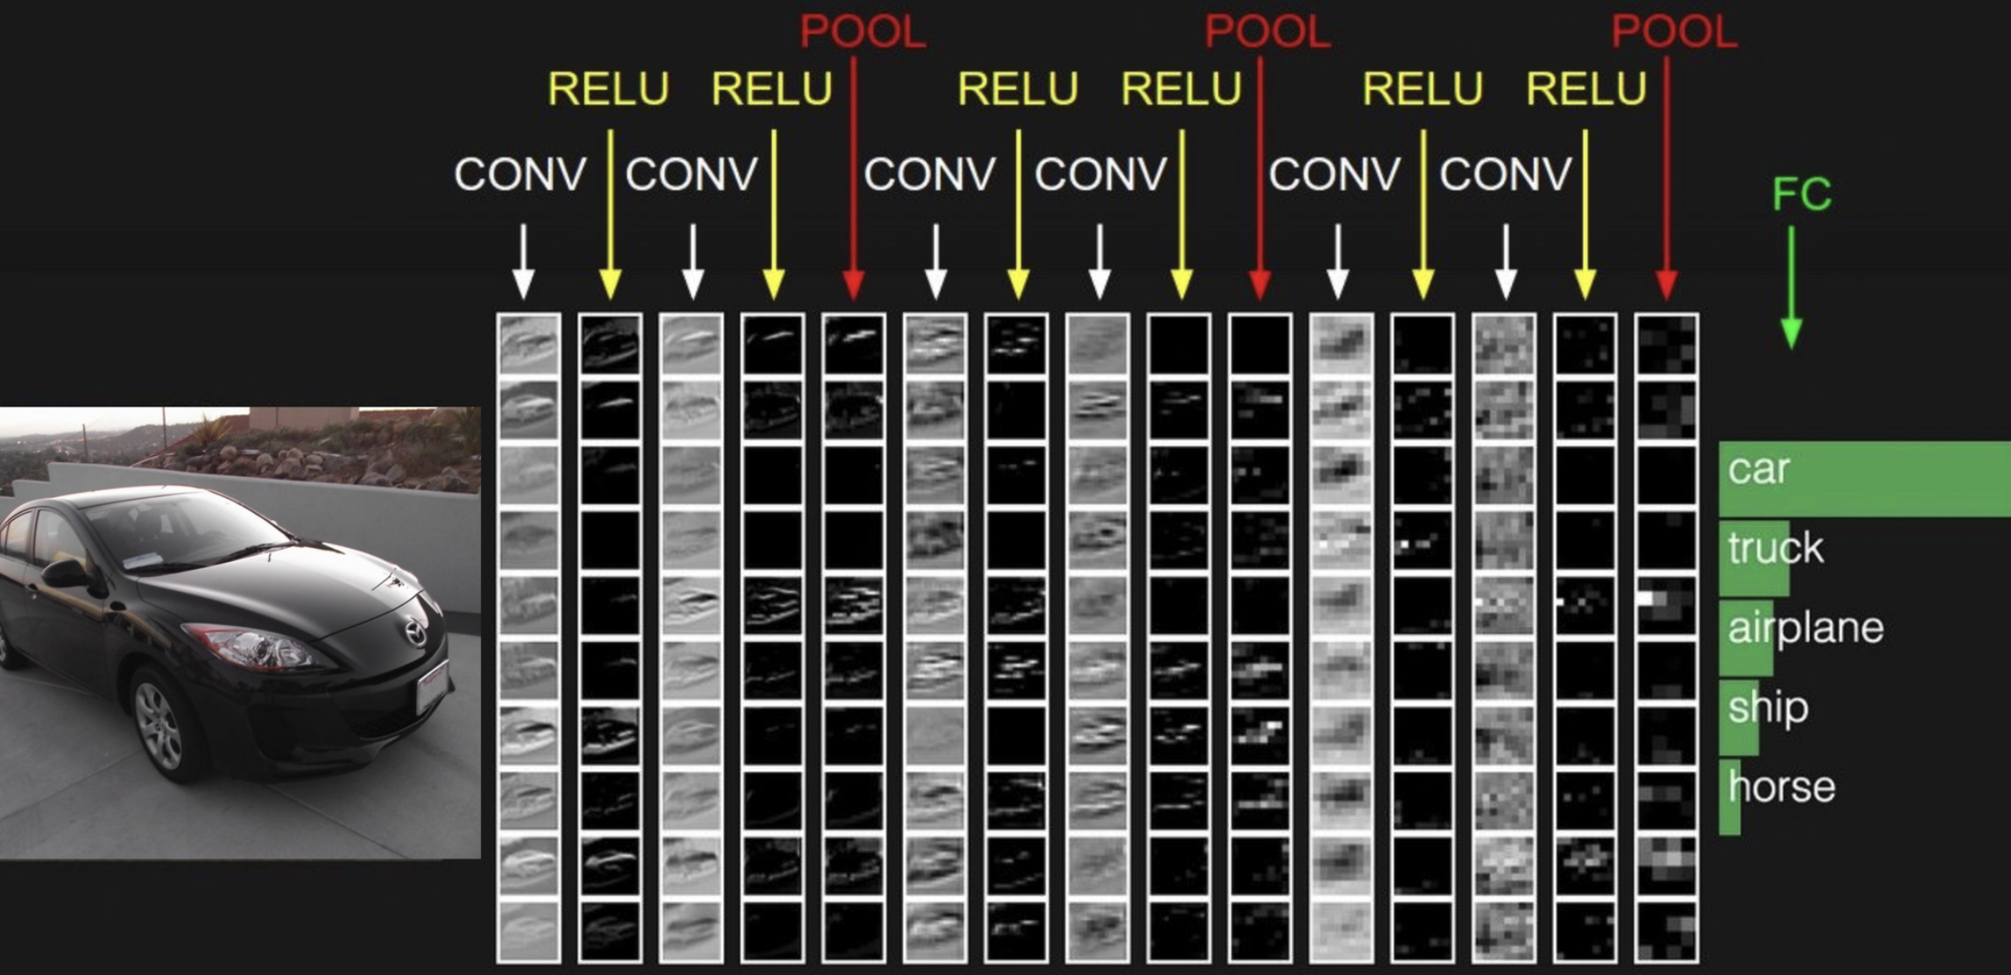
Example

